Slide 1
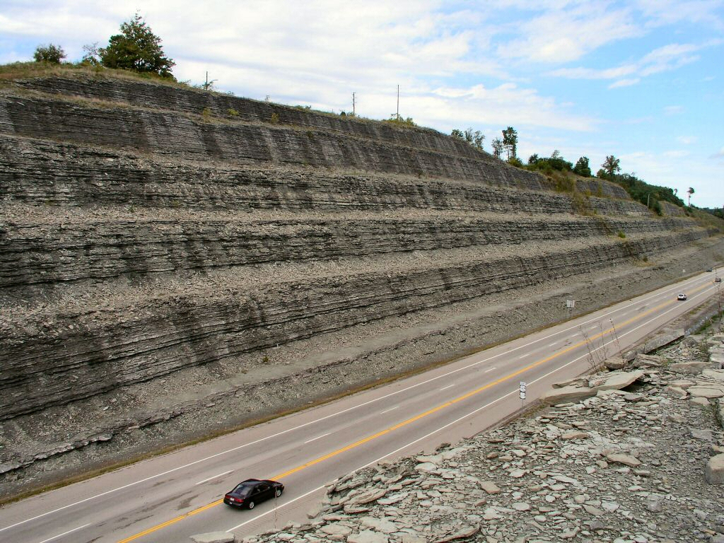
Notes:
This is an roadcut outside of Cincinnati, Ohio. The rocks are all made from ocean sediments that were deposited during the Ordovician period, or around 440 million years ago. By the way, that means that this part of the continent was underwater during this time.

Slide 2
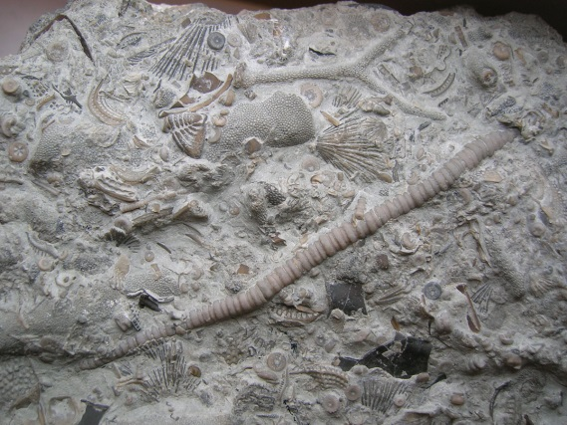
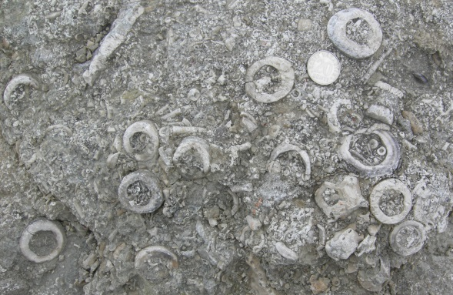
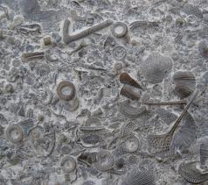

Notes:
Many of these rock layers contain marine fossils, including ancient corals, bryozoans, bivalves (or clams), gastropods (i.e., marine snails), and trilobites. Specimens collected from one of these layers comprise a collection—which is also a representation of what was living at this particular place at a particular point in time.

Slide 3

Notes:
Let’s zoom in on that first collection. In addition to seeing again all of the different types of organisms, you can also see that many of them are fragments of shells or pieces of the exoskeleton. So in order to figure out what was living in this community, we need to be able to identify fossil species from fragments. Now most rocks, including this one, have been cemented and it is hard to separate the fragments from the rock, but this is not always the case.

Slide 4
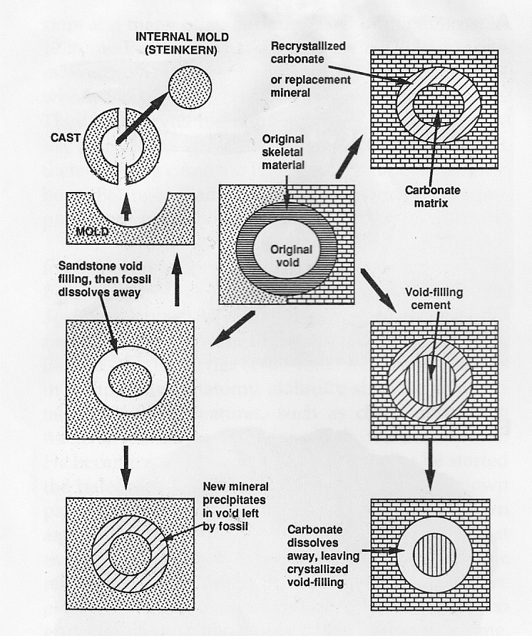
Notes:
But, every so often, when the rock is buried underground, the fossils will be dissolved away by groundwater and a different mineral will grow or precipitate into the void left behind. And every so often, that mineral is silica, or the same thing that quartz is made of. When this happens, we can take advantage of the fact that the cemented limestone mud dissolves in acid by the silica casts do not.
Prothero 1998 Bringing Fossils to Life

Slide 5
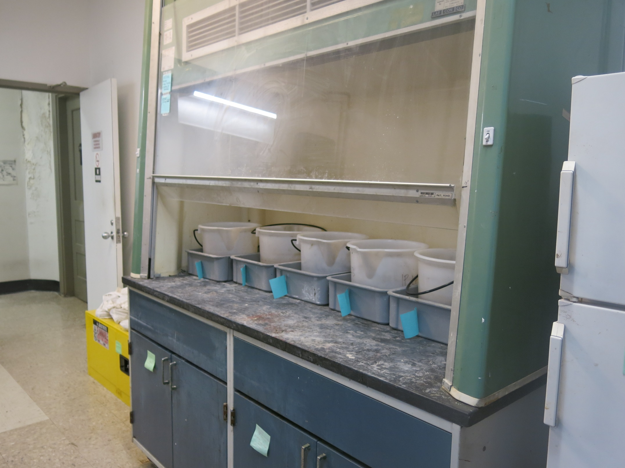
Notes:
Here we are dissolving rocks in acid baths in one of the fume hoods upstairs. Once the surrounding rock is dissolved, we can sieve out the fossil specimens that are left behind. One great thing about this method is that it is possible to liberate really really small (sub-mm) juveniles that would otherwise be really difficult to find.

Slide 6
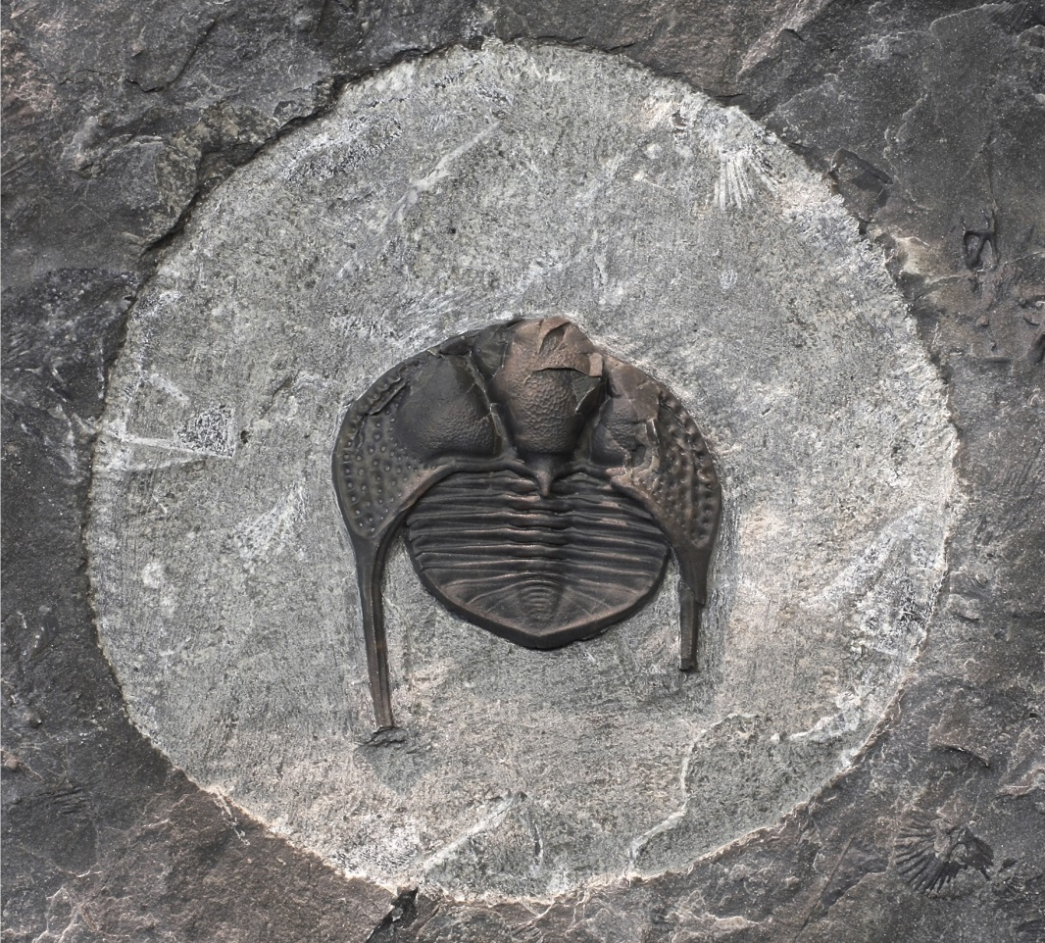
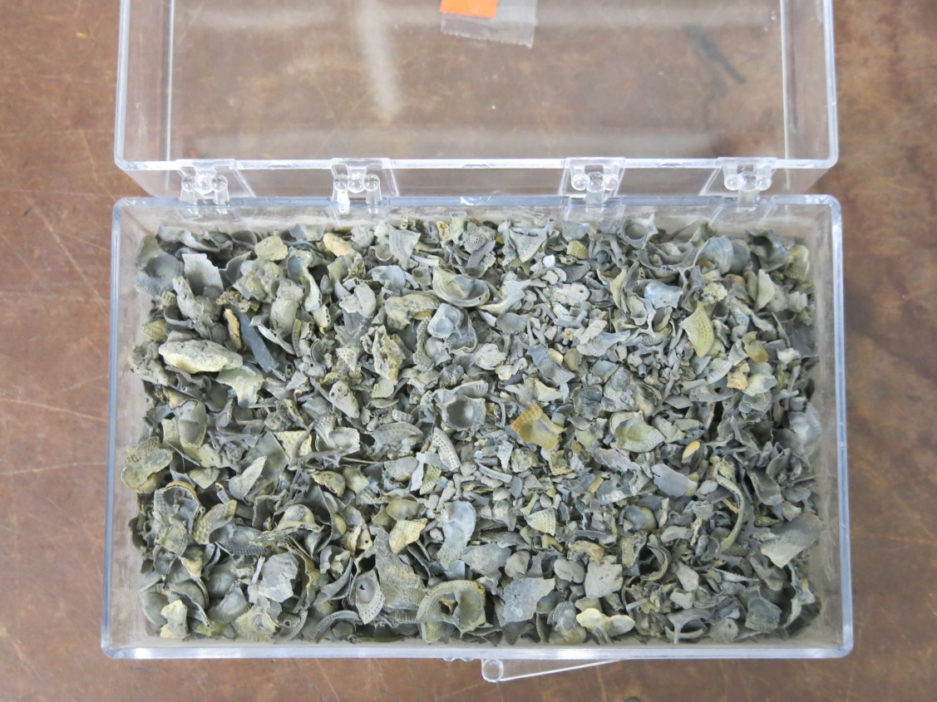
Notes:
Ordovician collections like this commonly have many trilobite fossils in them. Trilobites add another layer of complexity when counting specimens because they were made of many skeletal parts that often became disassociated after the individual organism died. To give you an idea, here is a picture of a complete Cryptolithus exoskeleton. And here are some Cryptolithus fossils in a rock layer. And here are a bunch of Cryptolithus fossils, but disarticulated and partially fragmented in some cases.

Slide 7
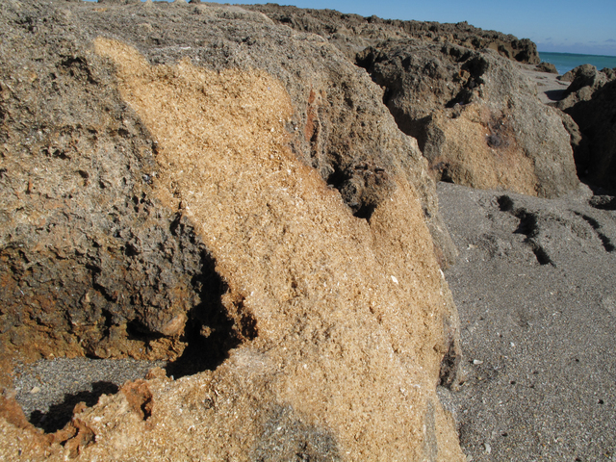
Notes:
There are also examples where the sediment deposits have are only partially lithified, meaning the sand grains have not been cemented together like the rock outside Cincinnati that I just showed you.
Here, for example, are sediments were deposited along the eastern Florida coast during the late Pleistocene, or about 500,000 years ago.

Slide 8
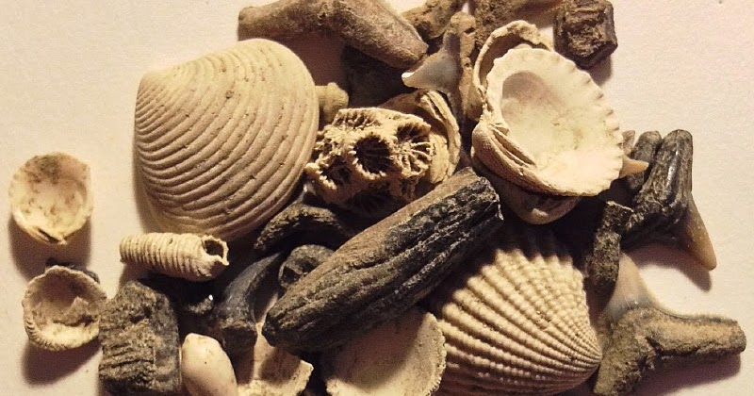
Notes:
What this means is that the fossil can be sieved out of the sediments and completely isolated from the rest of the sediment. Then it’s just a question of identifying everything—once you know what’s there, you can tally the total diversity and relative abundances of the different species. Once you’ve done this for many collections, it is possible to figure how communities changed over time, especially in areas where the environment or climate was also changing.

Slide 9
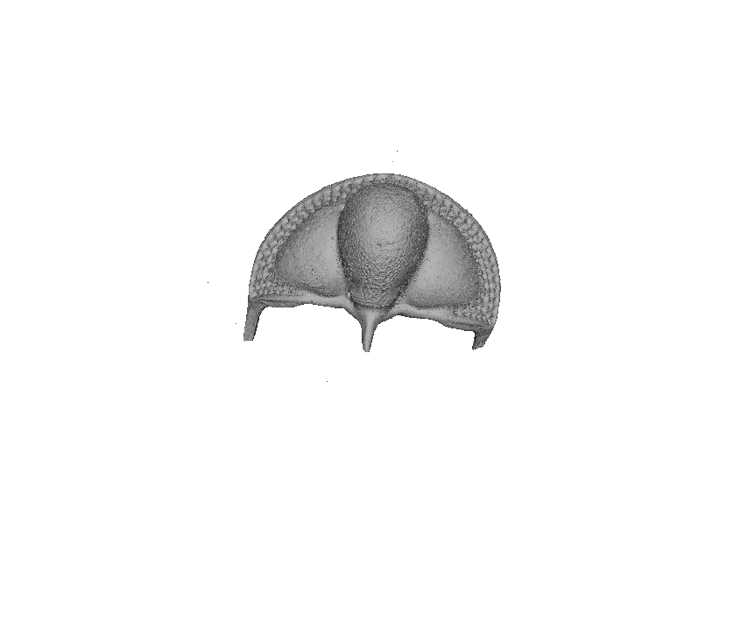
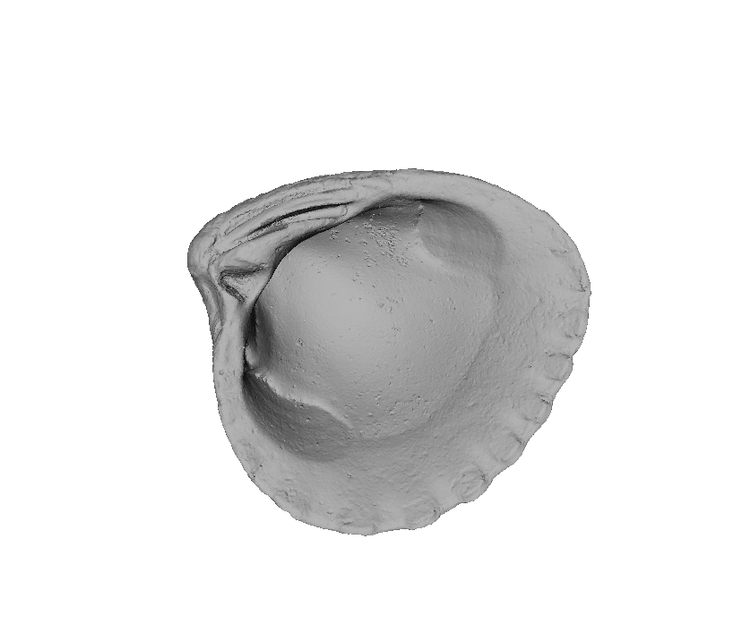
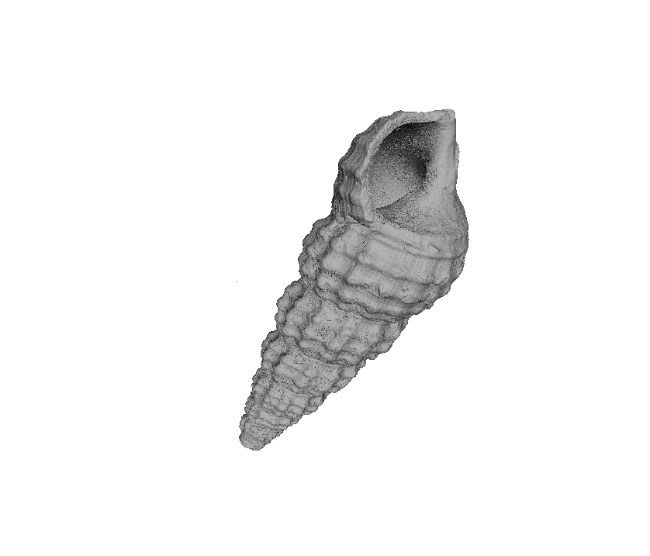
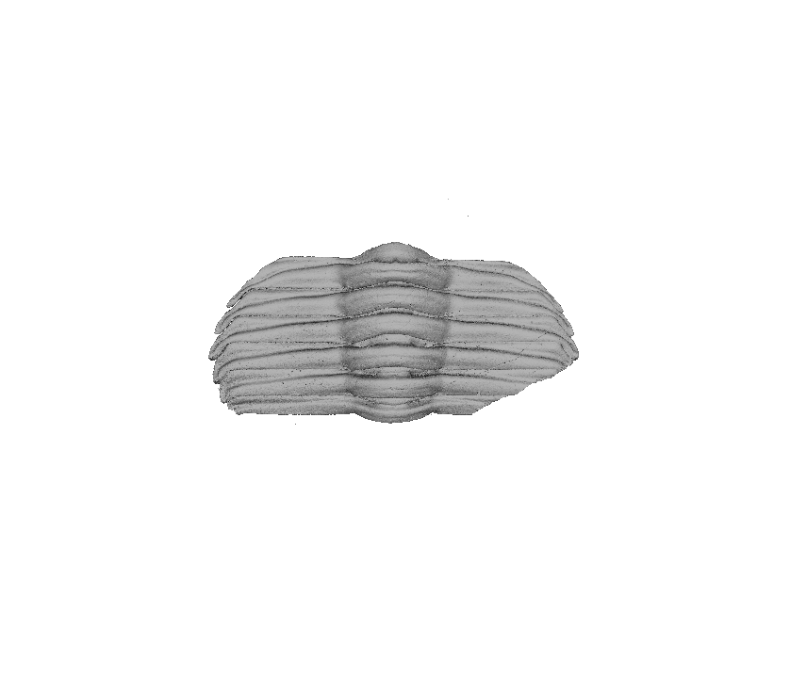
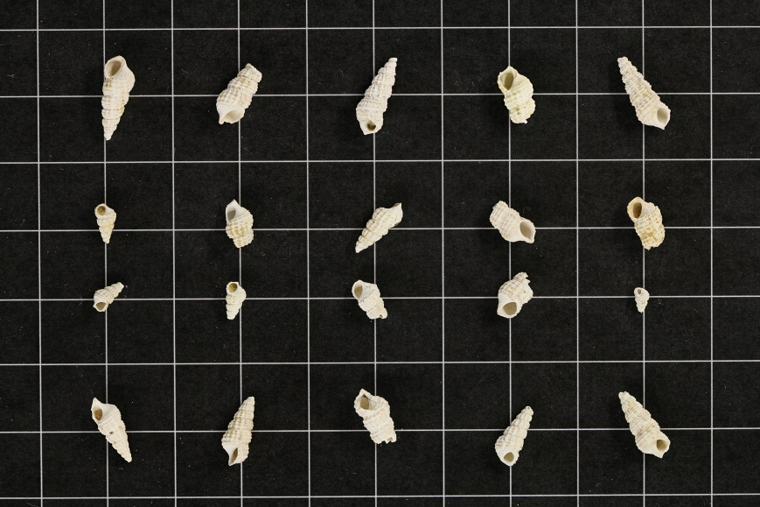
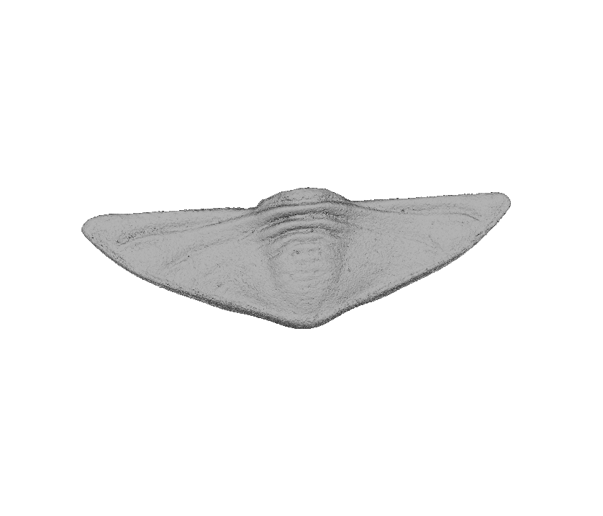
Notes:
But as you might imagine, identifying and counting specimens, especially a bunch of fragments, is difficult and time-consuming. This is the basis for the “Fossil Fragmenter Challenge”. I have made 3D surface models of museum specimens representing the different parts of the trilobite Cryptolithus and a bivalve and a gastropod. I’ve also taken a bunch of pictures of specimens of the same species in different orientations and degrees of fragmentation. What I want to know is if we can use the 3D models to make a virtual set of fragments that can be used to train an algorithm or program to identify the different fragments.

Slide 10
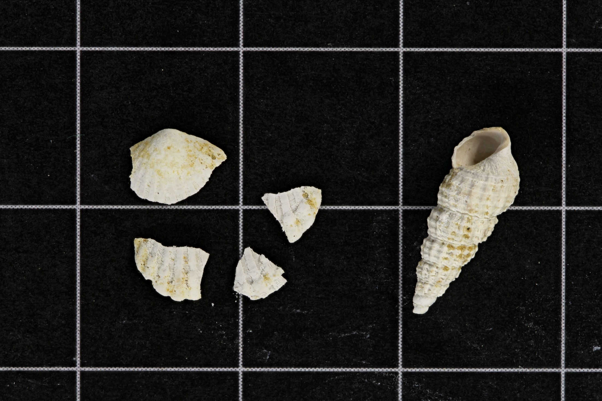
Notes:
And just to lay on one extra layer of difficulty: Ultimately we want to know how many individuals there were! But it is difficult to tell whether each individual organism is represented by one or many fragments. Here, for example, is this made-up collection, there is one gastropod and one bivalve. If you counted each fragment as a unique individual, you would end up thinking that bivalves were really abundant compared to gastropods when the truth was that they were equally abundant.

Slide 11
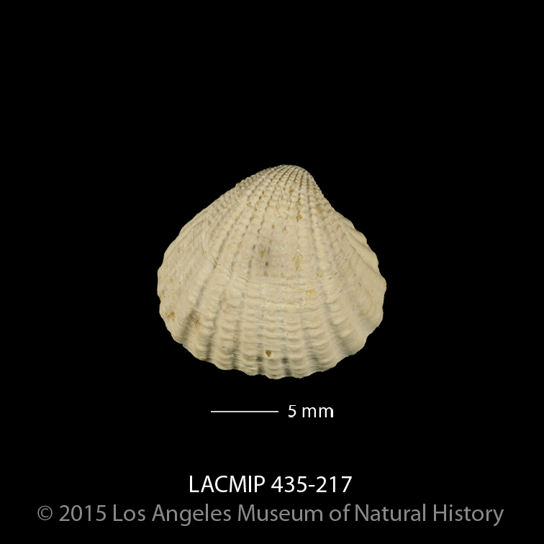
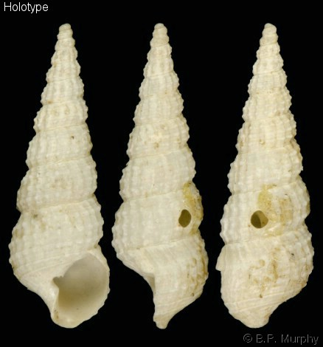
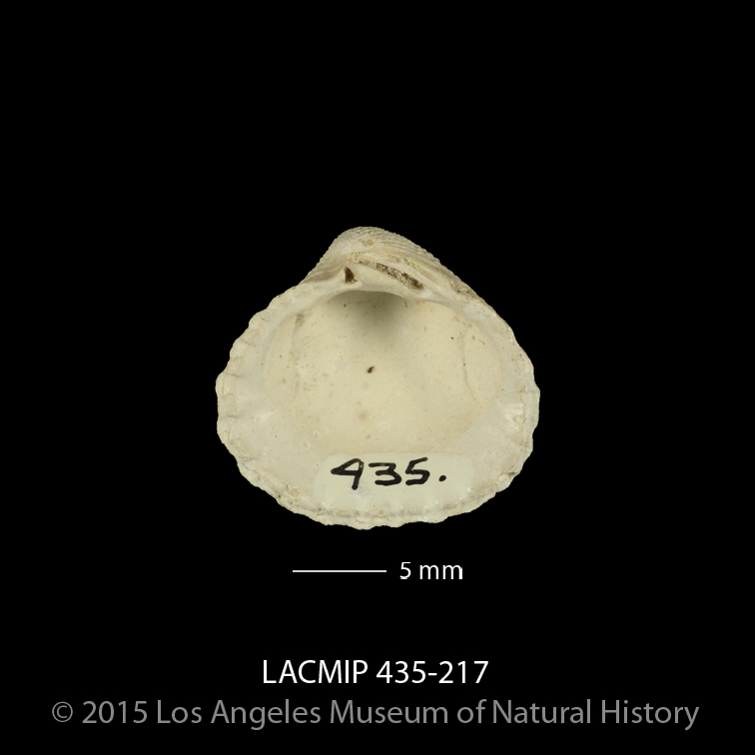
UMBO
APERTURE
Notes:
Fortunately, there are unique features on both bivalves and gastropods that are likely to be only on one of those fragments. For bivalves, that is the umbo, or the oldest part of the shell (this bivalve grew bigger by adding layers away from this point). For gastropods, this is the aperature, or the opening to the shell. If we just count fragments with umbos or fragments with aperatures, the chances are better that we’ll get more accurate abundances of each species in the collection.

Slide 12
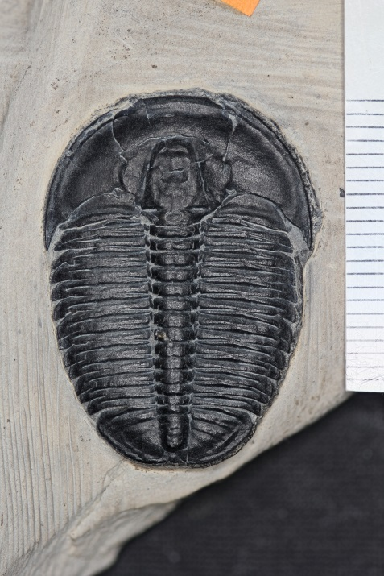
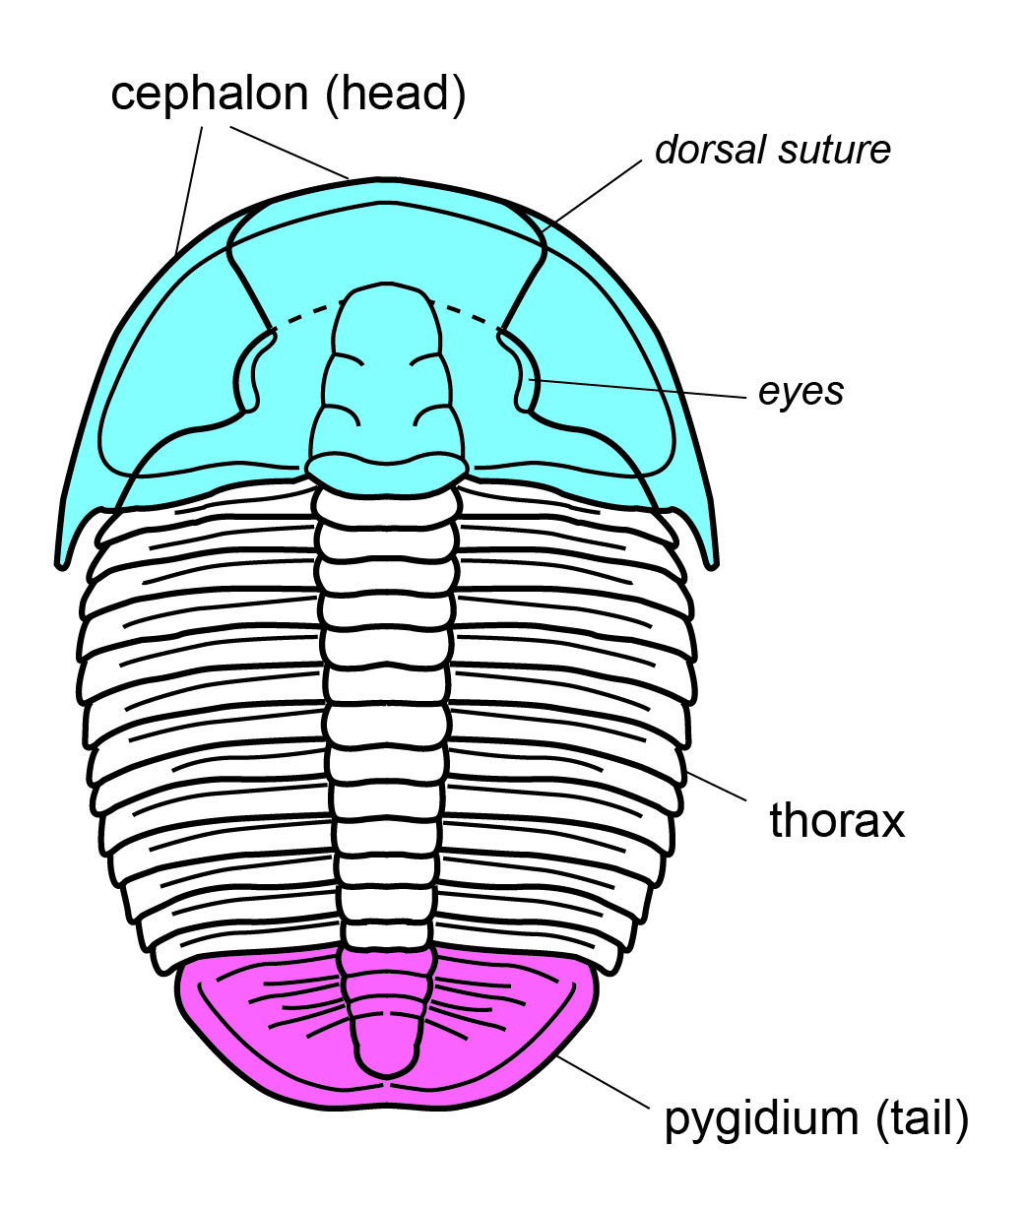
Notes:
As for those trilobite parts, there is even more we can do, and this takes me to a second challenge, the “Trilobite Bits” challenge. So I mentioned that the trilobite exoskeleton is made of jointed parts. These are what those different regions are called. But note that the thorax is actually made of many elongate segments that are also jointed—here in this species there are 13 segments in the thorax.

Slide 13
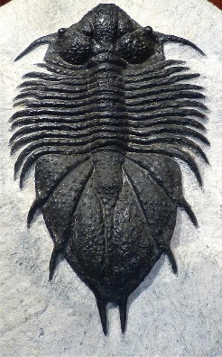
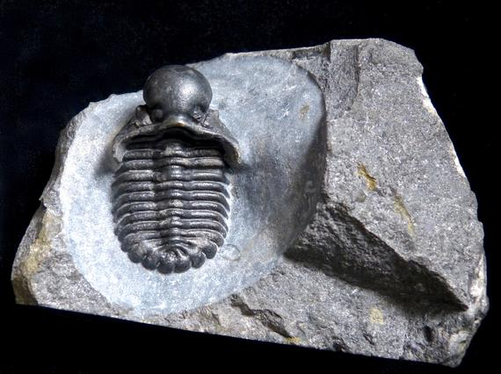
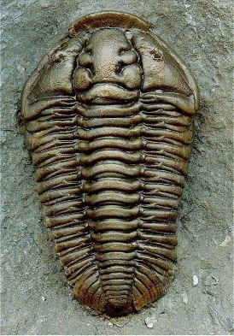
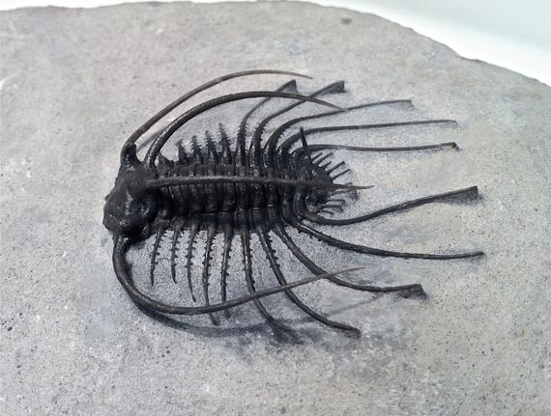
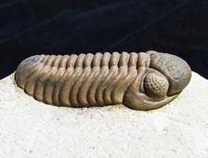
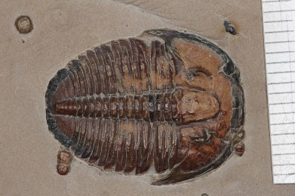
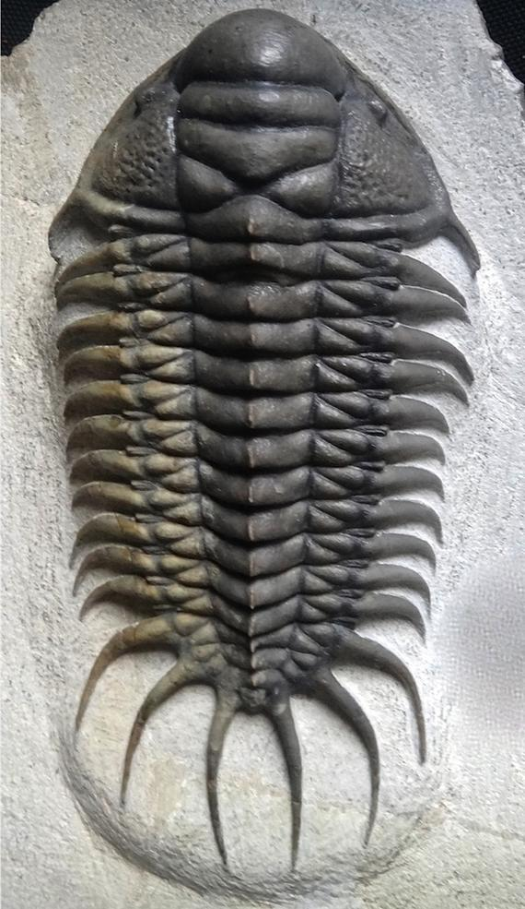
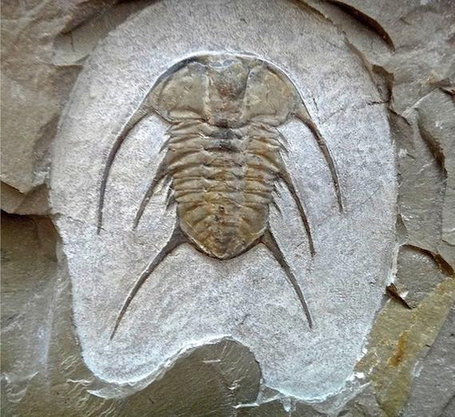
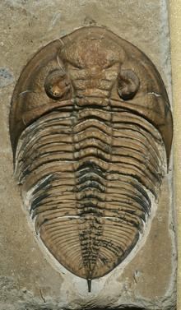
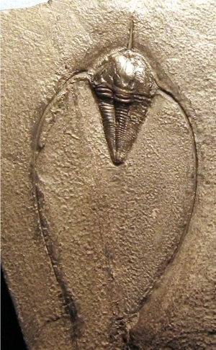
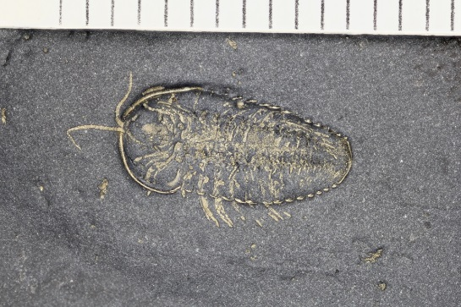
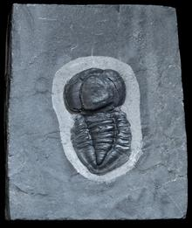
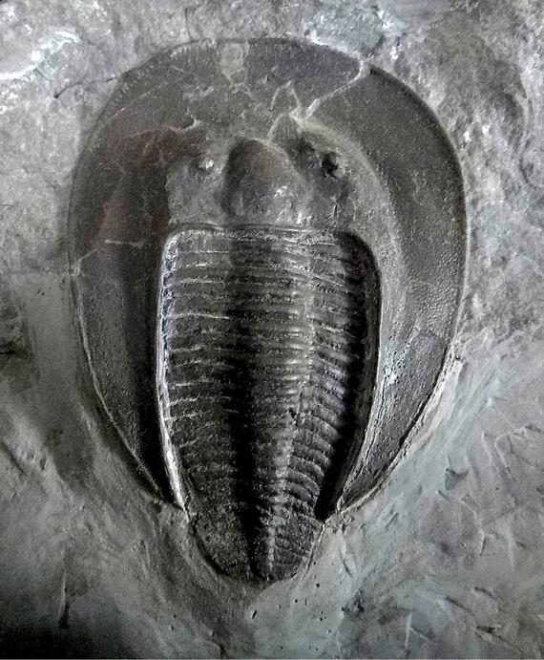
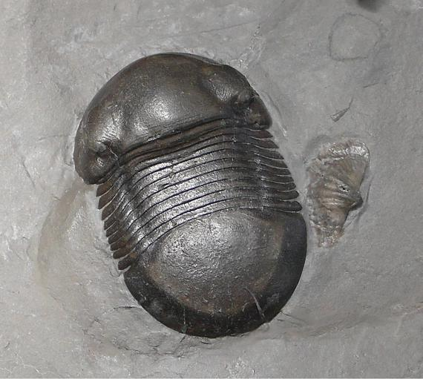
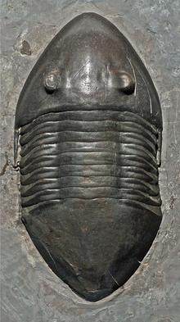
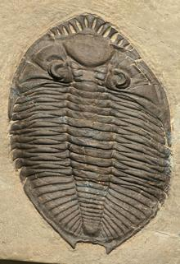
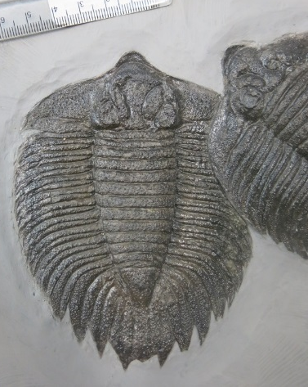
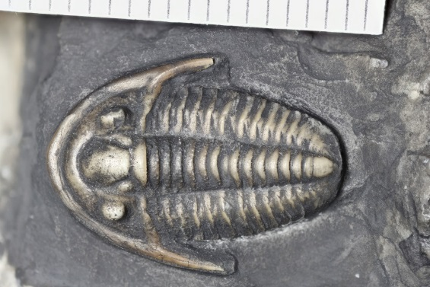
Notes:
And all trilobites exoskeletons had these three regions, even though they can look dramatically different from one another. In addition, the number of segments in the thorax varied from only a few to scores (48). Knowing the number of segments is important for two areas of trilobite research.

Slide 14

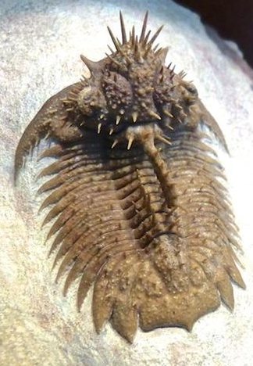
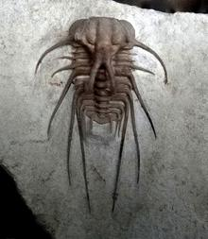
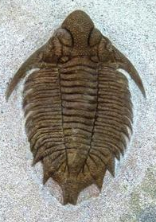
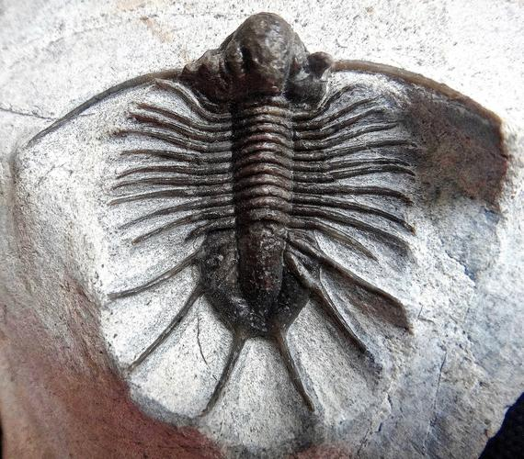
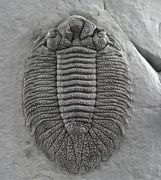
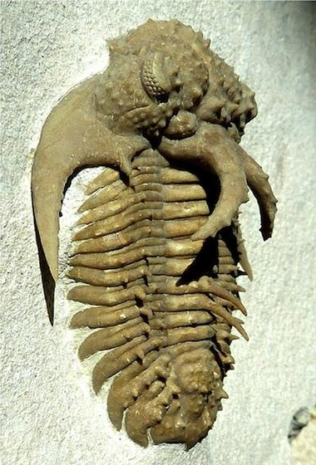
Notes:
First, some trilobite groups were very conservative in the number of segments that each species had. These are all lichid trilobites—they are very diverse in terms of the numbers of spines they had, and the arrangement of grooves and lobes. But they all had 11 segments—over 450 species with no variation in the number of segments. Just how variable this was within different groups, and how this changed over time can say something about how diversification happened in these groups—i.e. it says something about why they evolved the way that they did.

Slide 15
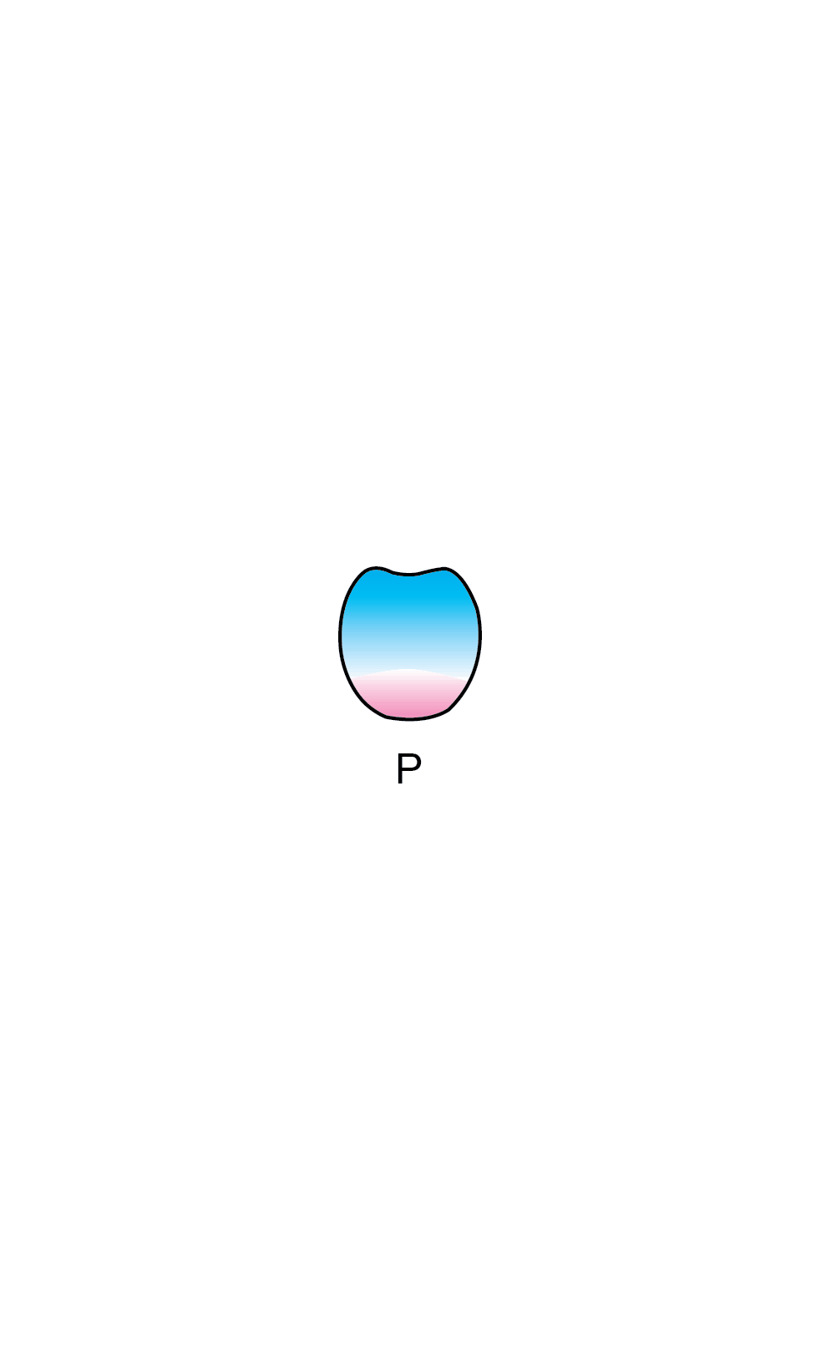
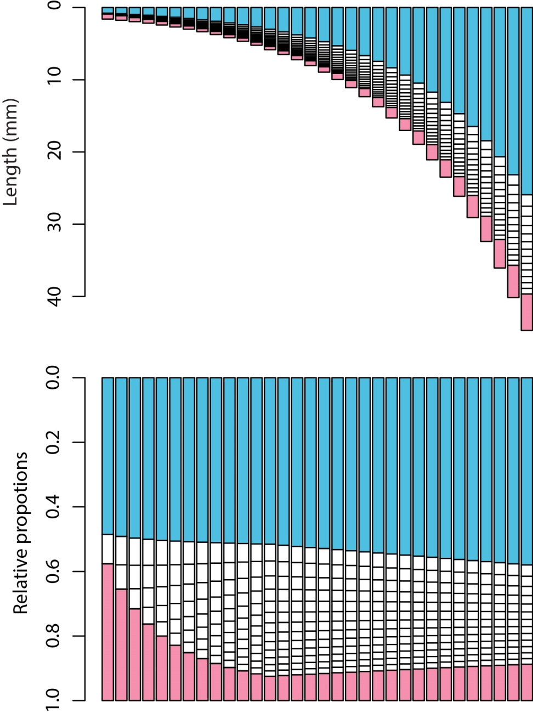
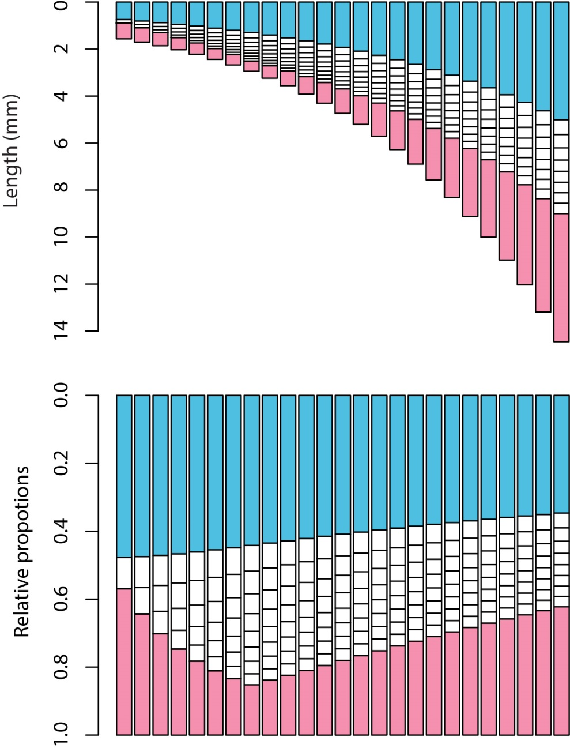
Growth
Growth
Notes:
On reason there are clues about trilobite evolution in the number of segments is because segments were added during growth. In addition, each one of these parts—the cephalon, the thoracic segments, and the pygidium—could grow at different rates, and as a result, the relative lengths of those parts changed over development. I am currently developing a model using R that describes this growth, and by tinkering with the input and growth rate parameters, I can make trilobites of different size and different relative proportions. Here you can see the output from this model, where the relative size of the cephalon (in blue), the thorax (in grayscale), and the pygidium (in pink) change over development and result in different relative proportions in the adults.

Slide 16
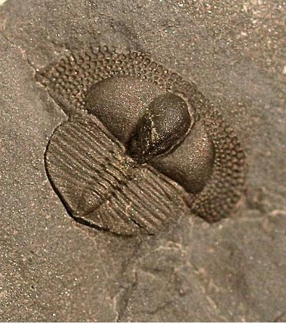
Growth
Growth
Notes:
But what I need now is to collect empirical data, so that I can go from simulations to reality.

Slide 17


Notes:
So the goal then of the “Trilobite Bits” challenge is to use computer vision to identify these major parts of the trilobite exoskeleton in our large gallery of trilobite images, and then gather data based on those identifications, including the relative length proportions of those parts, the number of segments in the thorax, and the presence of big spines and the segment they are associated with.

